Slide 1
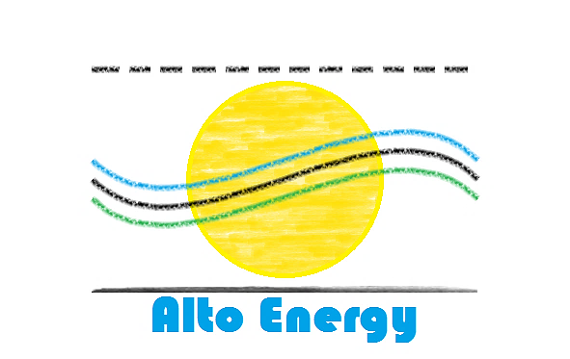



SENIOR DESIGN TEAM #14 SOLAR THERMAL GENERATOR

Slide 2
DESIGN ASPECTS:
SYSTEM INTEGRATION/HARDWARE DESIGN – ERNEST CRABTREE, EE
CONTROL PROGRAMMING/ BUDGET – SHAZEEN TARIQ, CE
GPS LOCATION AND TRACKING ALGORITHM – WILLIAM SIDEBOTTOM, CE
VOLTAGE CONDITIONING – JASON GALLA, EE
ENERGY STORAGE AND CHARGING – DYLAN LEE, EE
HEAT TRANSFER/WEBMASTER – BENJAMIN GALAVIN, EE

Slide 3
PROJECT GOALS
TEAM 14 SEEKS TO GENERATE 20W OF POWER FROM A PORTABLE SOLAR COLLECTOR DESIGN THAT EMPLOYS SEEBECK THERMAL ELECTRIC GENERATORS.
TRACK THE SUN ACR0SS THE SKY FROM ANY LOCATION AND TIME OF YEAR.
PROVIDE REMOVABLE ENERGY STORAGE THAT CAN BE USED IN A MODULAR SYSTEM
MAKE THE DESIGN USER FRIENDLY AND EASY TO SETUP/USE.
PACKAGE THIS DESIGN IN A LIGHT WEIGHT, WEATHER-PROOF, AND PORTABLE MEANS FOR CARRYING.

Slide 4
SOLUTION
IMPLEMENT A PARABOLIC COLLECTOR WITH SERVO MOTORIZED MOUNT IN COORDINATION WITH A STEPPER MOTOR
REMOVE HEAT USING WATER CONVECTION
REGULATE, BOOST, AND STORE ENERGY PRODUCED
USE GPS TO DETERMINE LOCATION. IMPLEMENT COMPASS MODULE FOR DIRECTION
IMPLEMENT MICROCONTROLLER FUNCTIONS TO CONTROL DISH POSITION
VERIFY THROUGH REAL WORLD TESTS AND EXPERIMENTS

Slide 5
BUDGET BREAKDOWN:
ITEM | COST | QUANTITY
Parabolic Dish | $108.85 | 1
Boost Converter | $12.49 | 1
Mount | $55.68 | 1
H-Bridge Drivers | $6.99 | 2
Compass Module | $6.22 | 1
Water Block | $9.99 | 1
TEG’s | $57.50 | 3
Digital Multimeter | $13.24 | 1
GPS Module | $24.60 | 1
TOTAL: | $417.46

Slide 6
SOLAR TRACKING CONTROL:

Slide 7
CHALLENGES:
Digital Compass output faulty, inconsistent results
New Compass Module has been ordered
Need to improve stepper motor functionality with shaft
Need to optimize heat transfer
Dish efficiency may be lower than expected due to non-reflective coating

Slide 8
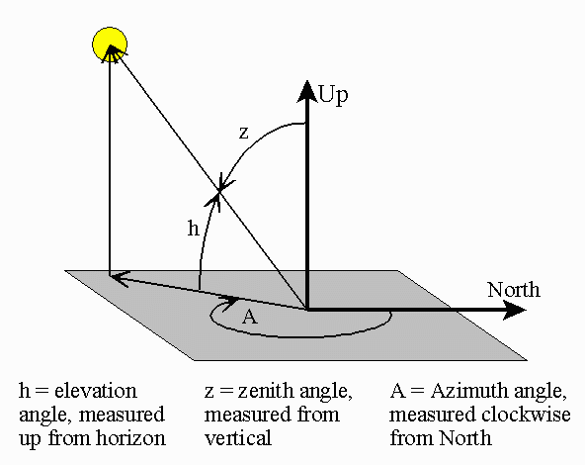
Solar Tracking
Originally tested the NREL’s solar position algorithm to track the sun.
The algorithm required too much dynamic (heap) memory than anticipated.
Switched to a smaller and slightly less efficient algorithm provided by the Institute of Earth Science.
Azimuth and Zenith angles calculated only off by tenths of a degree.
William Sidebottom

Slide 9
Solar Tracking
To test the new algorithm results were matched against those calculated from the Earth System Research Laboratory.
Coordinates and time were specifically entered for Tallahassee, FL at 12:00 pm Eastern Time 12/27/17
Output | Solar Tracking Algorithm | Earth System Research Laboratory
Zenith | 50.1645 [degrees] | 49.68 [degrees]
Azimuth | 160.9977 [degrees] | 160.76 [degrees]
William Sidebottom

Slide 10
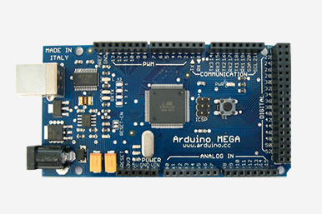
Solar Tracking
The Arduino Uno is currently being used as the micro controller of choice over the TI MSP430 due to limitations with Code Composer Studio.
Header and Implementation files were created for using the Solar Tracking Algorithm as Well as a more efficient stepper motor library.
The Arduino Mega is being considered due the number of IO pins and substantial memory capacity.
William Sidebottom

Slide 11
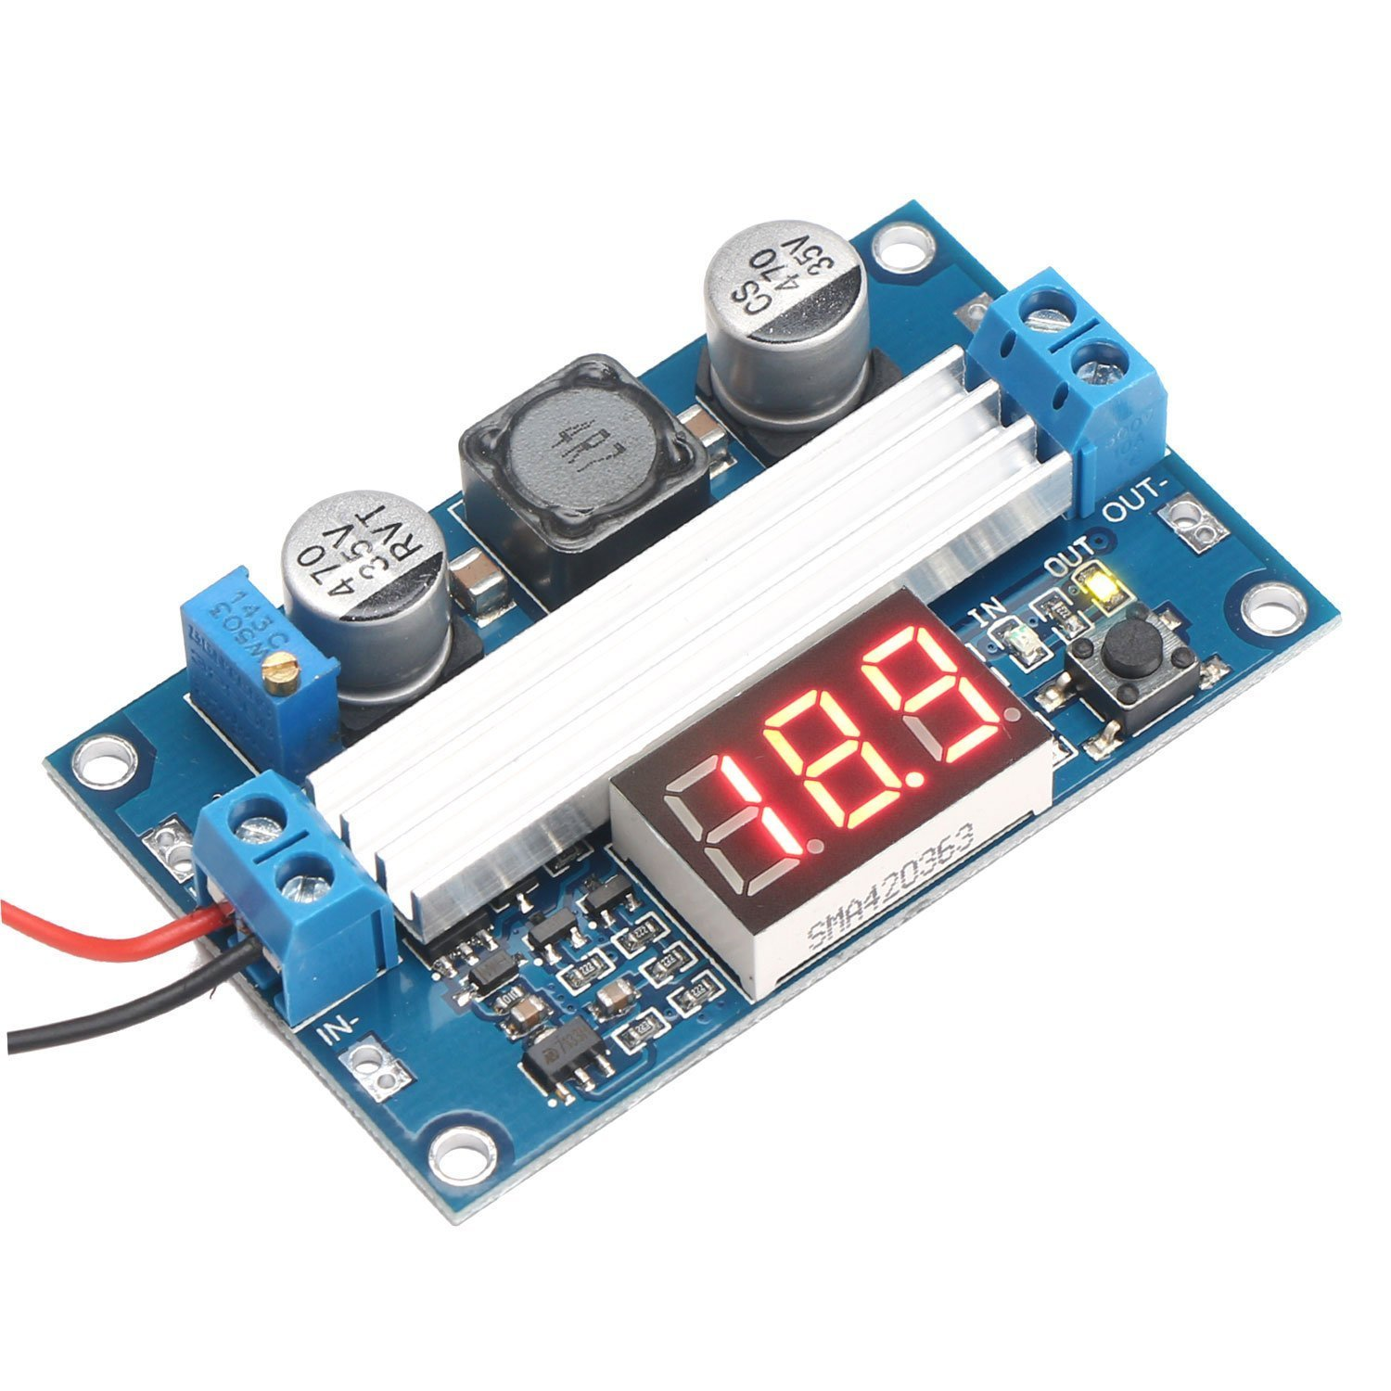
POWER REGULATION
Boost converter was originally going to be designed and implemented by team
More difficult and more expense than was expected
Purchased boost converter to implement
Can supply 6A at 12V – well above what is required
High efficiency (Claims up to 98%, 90% observed)

Slide 12
POSSIBLE ISSUES WITH VOLTAGE REGULATION
Output voltage from TEGs may be lower than expected
Boost converter requires at least 4 volts to turn on
May employ more than one chip in design if necessary in series to boost voltage output
Need to conduct real tests with chips before employing changes

Slide 13
Battery Charger/Discharger
IMAX B6 is the new intelligent multifunction charger which can charge and discharge for NiMH batteries
Capable of charging/discharging 1-15 NiMH cells
Operating voltage between 11 V and 18 V
Circuit power: Max Charge: 50W / Max Discharge: 5W
Charge Current Range: .1-5.0A
Discharge current range: .1-1.0A

Slide 14
Possible Issues:
Foresee issues with battery cell connection
Will not be ideal for user friendliness due to the user defined settings
Space will be limited within base

Slide 15
Verification/Testing
Optical Testing
Calculated focal length to be 8 inches above the base of the parabolic dish
Must determine optimal reflector size and shape
Calculate optimal distance of reflector from dish in order to evenly distribute heat over the surface of the chips

Slide 16
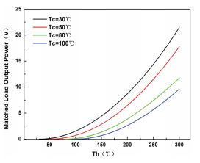
Verification/Testing
Power Requirements
Maximum output from single chip under ideal conditions is 22 Watts
Project objective is 20 Watts chip output in full sunlight
Implementing a single chip design to test output
Realistically we can expect approximately 10 Watts

Slide 17

Verification/Testing
Temperature Requirements
Ideal hot and cold side temperatures are 295°C (568K) and 30°C (303K) respectively
We will not know how well the dish is going to heat the chips until we perform tests
Must perform real world tests

Slide 18
Acknowledgements
OUR FACULTY ADVISOR
DR. RAJENDRA AUROA
OUR INSTRUCTORS
DR. JERRIS HOOKER
DR. MICHAEL DEVINE
OUR REVIEWER
DR. SASTRI PAMIDI
DR. JIM ZHENG
MECHANICAL CONSULTING
DR. WEI GUO
DR. SIMONE HRUDA

